Slide 1


Maratha Vidya Prasarak Samaj’s K.R.T. Arts, B.H. Commerce & A.M. Science (KTHM) College, Nashik. ​ ​
Department of Statistics
Affiliated to Savitribai Phule Pune University. (SPPU)
A project Presentation on
Thyroid Disease Detection Using Machine Learning Techniques
Presented By
Nikumbh Kalpesh Sanjay
Khairnar Krushnai Chandrakant
Bhamare Rutuja Nanaji
Under The Guidance Of
Prof. Mansi Hiray,
Department Of Statistics,
K.T.H.M College , Nashik

Slide 2
CONTENT
1) Acknowledgement
6) Data Description
2) Abstract
7) Methodologies
3) Introduction
8) Graphical Representation
4) Objectives
9) Analysis
5) Motivation
10) Conclusions

Slide 3
Acknowledgment
We have satisfaction with the completion of our project entitled “Thyroid Disease Detection Using Machine Learning Technique” at the Department of Statistics in “M.V.P. Samaj’s K.R.T. Arts, B.H. Commerce, A.M. Science College, Nashik” during the academic year of 2022-2023.
We owe Professor Mansi Hiray our gratitude for his direction and persistent supervision, as well as for providing the project with essential knowledge and for helping us finish the project. We were able to finish the assignment on time because of his consistent direction and desire to impart his wide knowledge.
We would like to show our gratitude to Dr. G. S. Phad, Head of the Statistics Department, for allowing us to work on this project and providing us with all the support we needed.
Additionally, we appreciate the invaluable advice and excellent cooperation from all the faculty in the Department of Statistics.

Slide 4
Abstract
Thyroid disorders are prevalent worldwide, affecting millions of individuals. Early and accurate detection of thyroid dysfunction is crucial for timely intervention and effective management.
In this project, we propose a machine learning-based approach for thyroid detection, leveraging the power of data-driven techniques to enhance diagnostic accuracy.
The data is carefully pre-processed to handle missing values and outliers ensuring its suitability for subsequent analysis.
Multiple machine learning algorithms, such as decision trees, support vector machines, and others, are employed to build predictive models.
This project contributes to the field of medical diagnostics by showcasing the potential of machine learning techniques in improving the detection and diagnosis of thyroid conditions.

Slide 5
Introduction
Thyroid disorders, including hypothyroidism, and hyperthyroidism, pose a significant health concern globally. These conditions can lead to various complications if left undiagnosed or untreated.
In recent years, machine learning techniques have shown great potential in the field of medical diagnostics, offering powerful tools for automated detection.
Traditionally, thyroid disorders have been diagnosed through a combination of clinical evaluation, physical examination, and laboratory tests. While these methods are valuable and can be time-consuming.
Machine learning algorithms provide an opportunity to overcome these limitations by utilizing computational power to automatically learn patterns and make predictions from large datasets.
Machine learning algorithms, including decision trees, support vector machines, and others, will then be trained on the data to build predictive models.

Slide 6
Objectives
To build a machine learning model capable of more precisely detecting thyroid abnormalities or diseases based on input data.
To improve the accuracy of thyroid disease diagnosis compared to traditional methods.
To develop a personalized approach that takes into account individual patient characteristics, such as age, gender, and medical history.
To create a reliable and efficient system that can assist medical professionals.
To enhance the accuracy of detecting thyroid disease using several ML techniques.

Slide 7
Motivation
The subject of project is decided as need of perfect, precise diagnosis of disease. In medical field sometimes it is very hard to give errorless prediction Some diseases are that type which needs early detection and proper treatment.
There are several significant factors by which the project is influenced such as improved diagnostic accuracy , efficiency and time saving , reduction in healthcare costs ,research and development .
Improved diagnostic accuracy - By improving the accuracy of thyroid disorder detection, early intervention and treatment can be initiated, leading to better patient outcomes.
Efficiency and Time-Saving - Instead of relying solely on manual analysis by radiologists or physicians, a trained model can quickly analyse medical images and provide preliminary findings. This can save time for healthcare professionals and enable them to focus on interpreting complex cases or making critical
Reduction in healthcare costs - By minimizing the need for extensive manual analysis and improving the accuracy of detection, unnecessary follow-up tests and procedures can be avoided. This can lead to cost savings for both patients and healthcare systems.

Slide 8
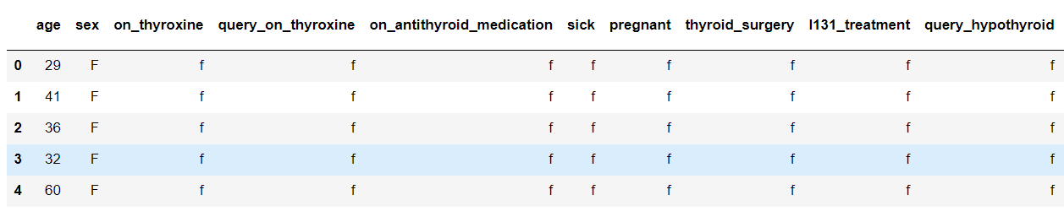
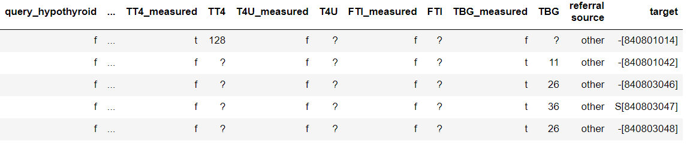
Data Description
We collected secondary data ( Thyroid dataset & Thyroid attribute names ) from the UCI repository.
Dataset consists of 29 attribute values such as age, sex, on thyroxine, query on thyroxine, on antithyroid medication, sick, etc
After cleaning the data set we got 21 attributes. Among them, TSH is Thyroid Stimulating Hormone, T3 is triiodothyronine, T4 is Thyroxine, T4U is Thyroxine Uptake, and FTI is Free Thyroxine index.

Slide 9
Methodologies
Logistic Regression
SVM
Decision Tree
Random Forest
XGBoost
AdaBoost
KNN
PCA

Slide 10
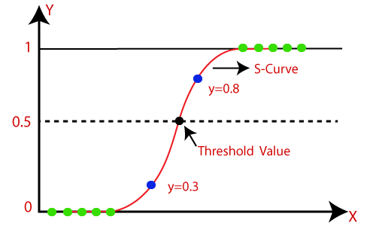
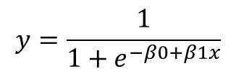
Methodologies
Logistic Regression
Logistic regression is used for predicting categorical dependent variables using the given set of independent variables. It predicts two values 0 and 1.
Logistic Regression algorithm has been implemented with the help of the sklearn library and an 86.82% accuracy score is obtained.
Logistic Regression equation as follows.
SVM
Decision Tree
Random Forest
XGBoost
$$y=\frac{1}{1+e^{−β0+β1x}}$$
AdaBoost
KNN
PCA
Image source: Google

Slide 11
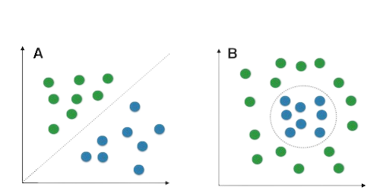
Methodologies
SVM
Logistic Regression
SVM works by mapping data to a high-dimensional feature space so that data points can be categorized, even when the data are not linearly separable. It aims to maximize the margin between the hyperplane and the nearest data points of each class.
SVM algorithm has been implemented with the help of the sklearn library and an 87.02% accuracy score is obtained
Decision Tree
Random Forest
XGBoost
AdaBoost
SVM has two types Linear SVM and Nonlinear SVM
KNN
PCA
Image source: Google

Slide 12

Methodologies
Decision Tree
Logistic Regression
A decision tree is a tree-structured classifier. In a decision tree, internal nodes represent the features of the dataset, branches represent the decision rules and each leaf node represents the outcome.
Decision Tree algorithm has been implemented with the help of the sklearn library and 95.08% accuracy score is obtained
SVM
Random Forest
XGBoost
AdaBoost
KNN
PCA
Image source: Google

Slide 13
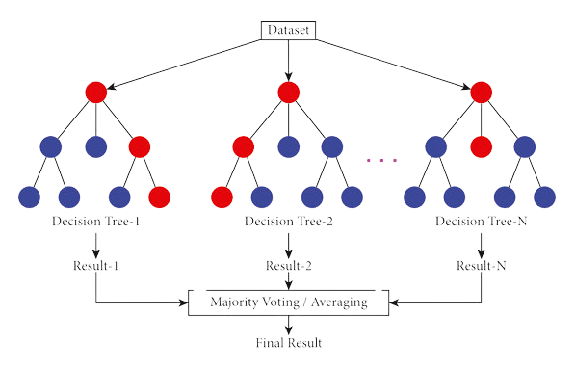
Methodologies
Random Forest
Random Forest is a classifier that contains a number of decision trees on various subsets of the given dataset and takes the average to improve the predictive accuracy of that dataset.
The greater number of trees in the forest leads to higher accuracy and prevents the problem of overfitting.
Random Forest algorithm has been implemented with the help of the sklearn library and 96.44% accuracy score is obtained
Logistic Regression
SVM
Decision Tree
XGBoost
AdaBoost
KNN
PCA
Image source: Google

Slide 14
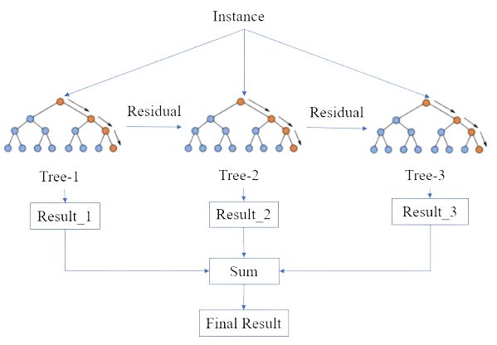
Methodologies
XGBoost
Logistic Regression
XGBoost is a supervised machine-learning method for classification and regression. This method is based on decision trees and improves on other methods such as random forest and gradient boost.
XGBoost algorithm has been implemented with the help of the sklearn library and 96.02% accuracy score is obtained
SVM
Decision Tree
Random Forest
AdaBoost
KNN
PCA
Image source: Google

Slide 15
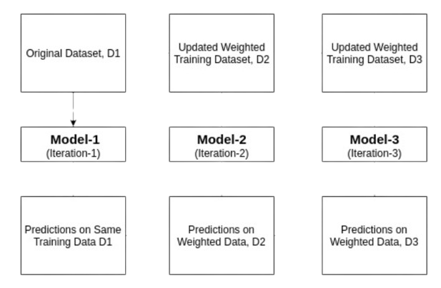
Methodologies
AdaBoost
Logistic Regression
AdaBoost is a machine learning ensemble algorithm that combines weak classifiers to create a strong classifier. It iteratively adjusts weights to focus on misclassified instances, improving overall performance.
AdaBoost algorithm has been implemented with the help of the sklearn library and 94.97% accuracy score is obtained
SVM
Decision Tree
Random Forest
XGBoost
KNN
PCA
Image source: Google

Slide 16
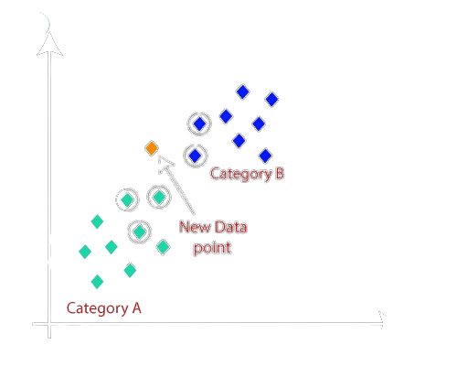
Methodologies
KNN
Logistic Regression
SVM
K-NN algorithm assumes the similarity between the new case/data and available cases and put the new case into the category that is most similar to the available categories.
KNN algorithm has been implemented with the help of the sklearn library and 85.77% accuracy score is obtained
Decision Tree
Random Forest
XGBoost
AdaBoost
PCA
Image source: Google

Slide 17
Methodologies
PCA
PCA is a widely used statistical technique in the field of data analysis and dimensionality reduction. PCA aims to transform a dataset consisting of possibly correlated variables into a set of uncorrelated variables called principal components.
The accuracy we are obtaining for logistic regression using PCA is 77.61%
The accuracy we are obtaining for SVM using PCA is 87.02%
The accuracy we are obtaining for Decision tree using PCA is 94.45%
The accuracy we are obtaining for Random Forest using PCA is 96.33%
The accuracy we are obtaining for XG Boost using PCA is 95.60%
The accuracy we are obtaining for Ada Boost using PCA is 94.56%
The accuracy we are obtaining for KNN using PCA is 85.98%

Slide 18
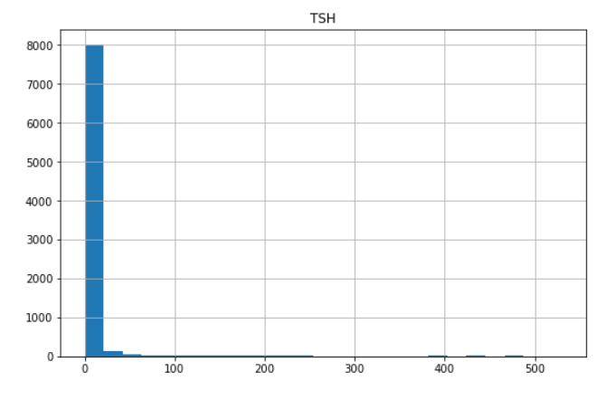
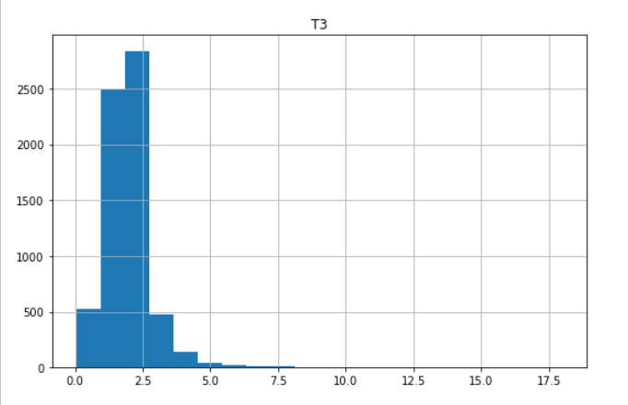
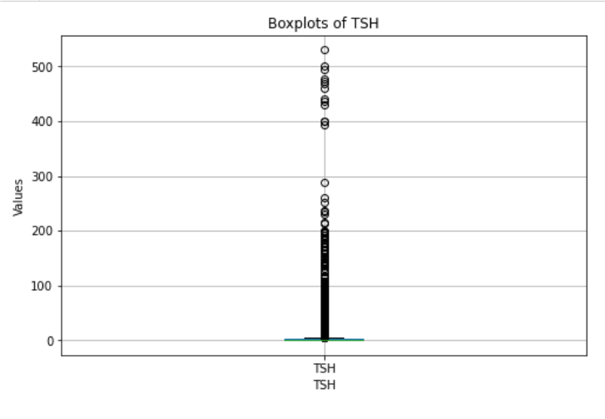
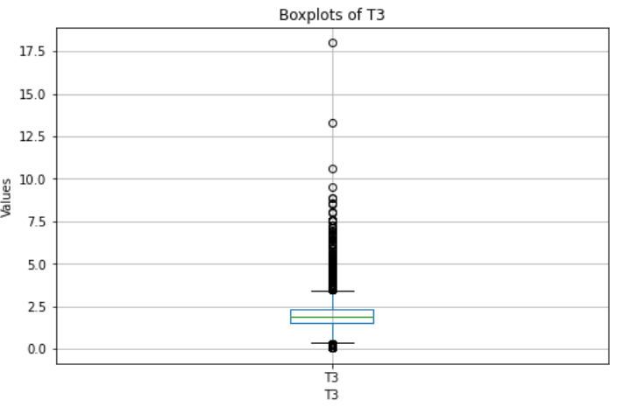
Graphical Representation
Thyroid Stimulating Hormone
Before Cleaning
T3 or Triiodothyronine

Slide 19
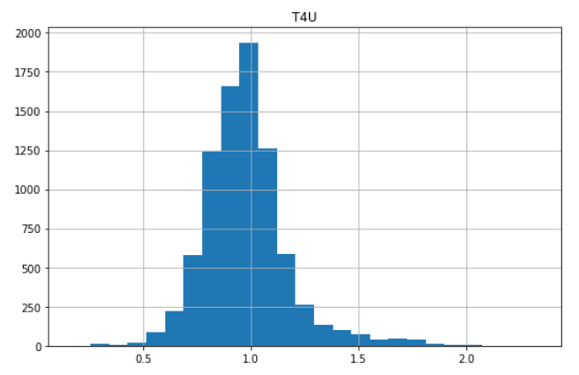
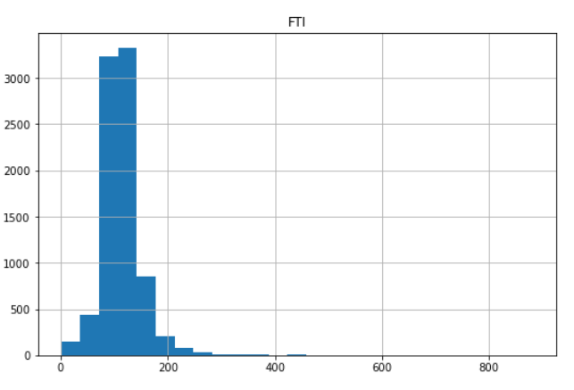
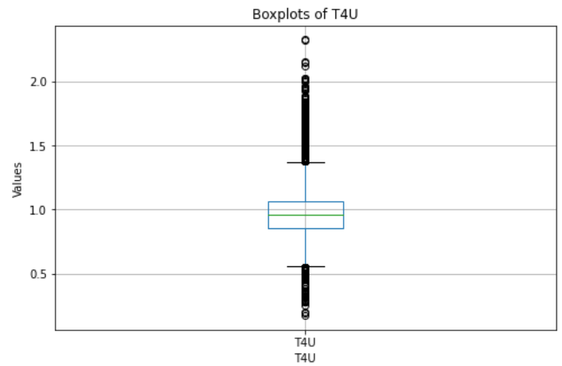
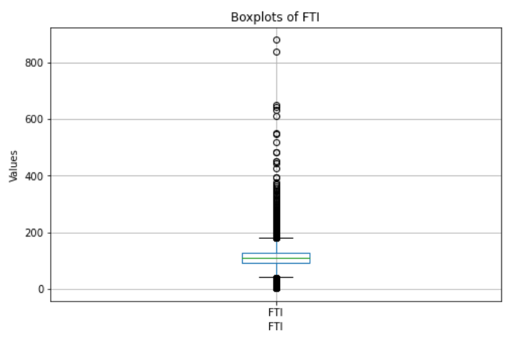
Graphical Representation
T4U or Thyroxine Uptake
Before Cleaning
Free Thyroxine Index

Slide 20
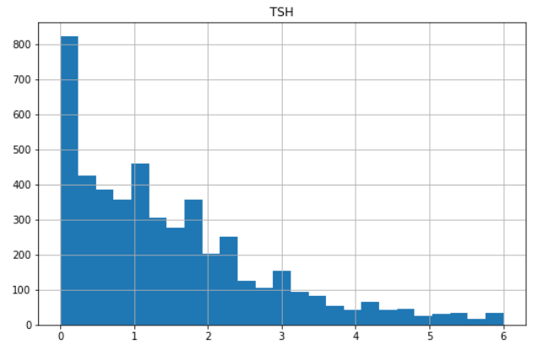
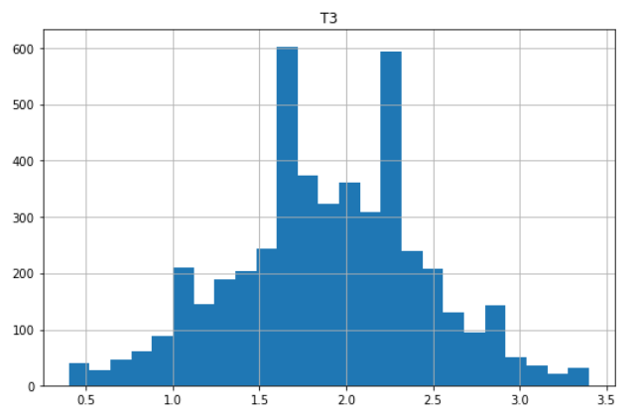
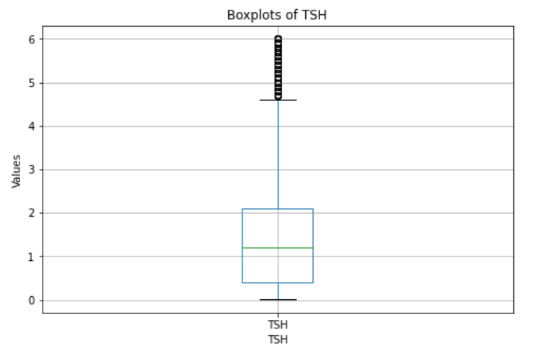
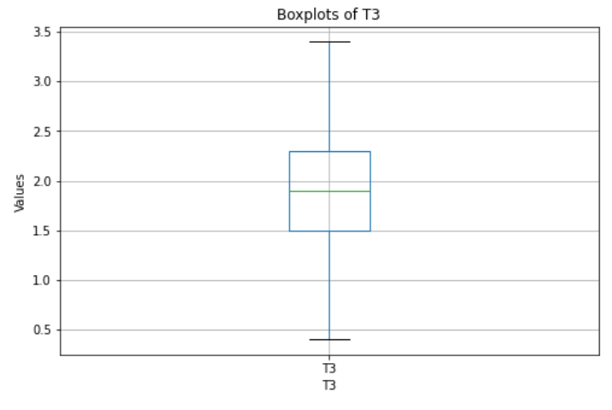
Graphical Representation
Thyroid Stimulating Hormone
After Cleaning
T3 or Triiodothyronine

Slide 21
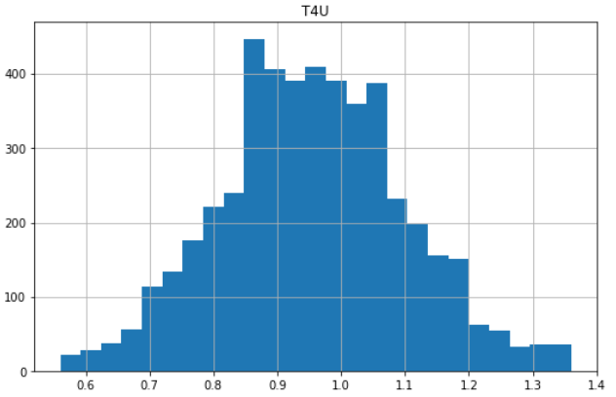
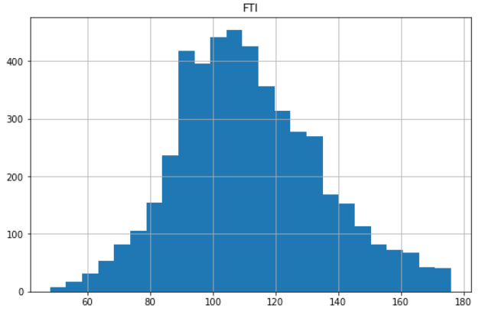
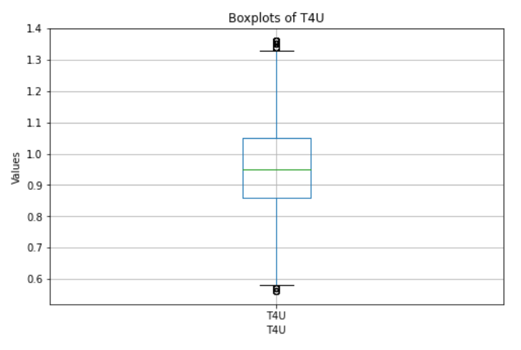
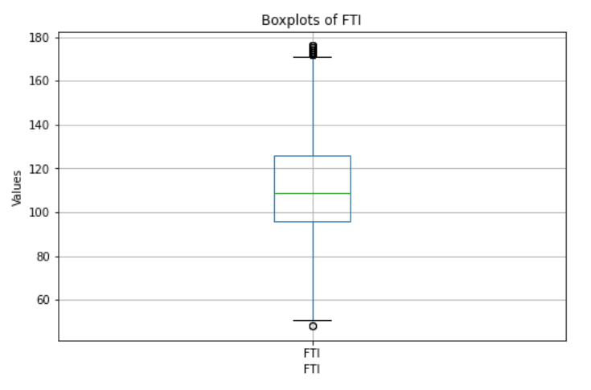
Graphical Representation
T4U or Thyroxine Uptake
After Cleaning
Free Thyroxine Index

Slide 22
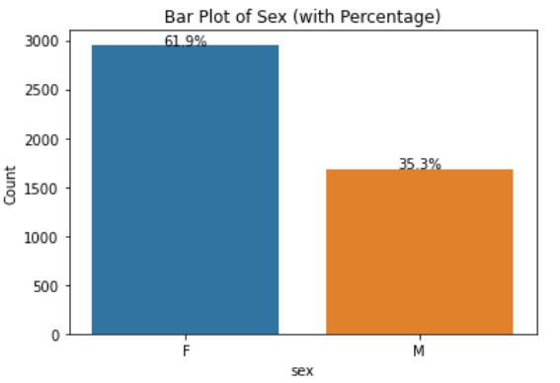
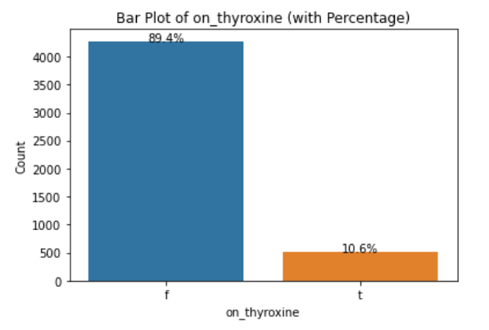
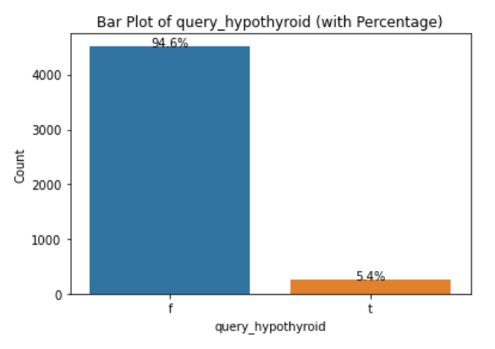
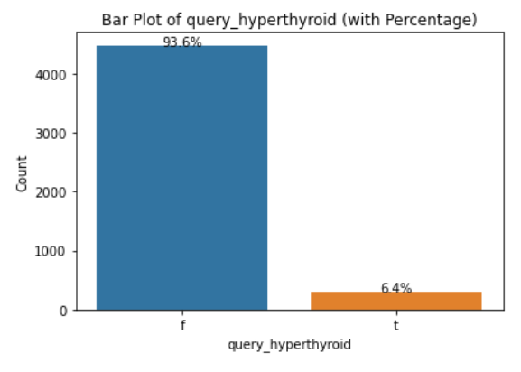
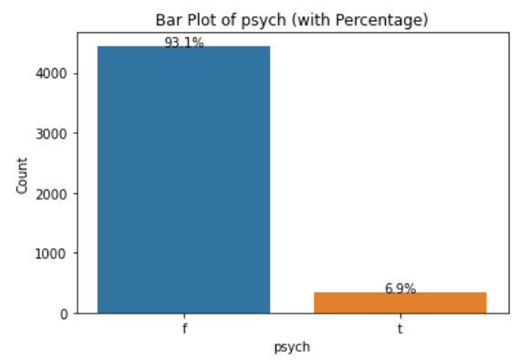
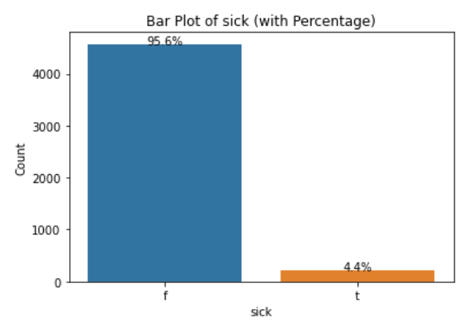
Graphical Representation

Slide 23
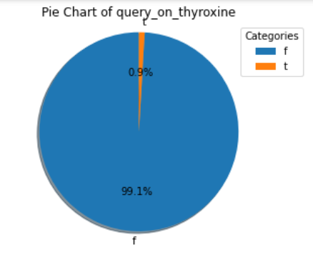
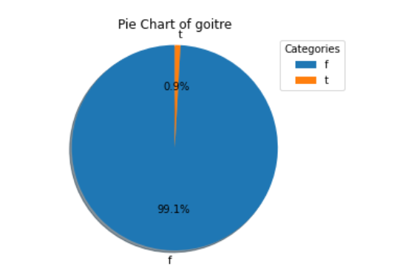
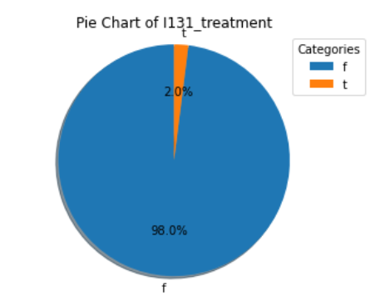
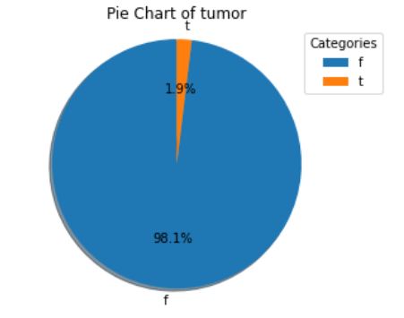
Graphical Representation

Slide 24
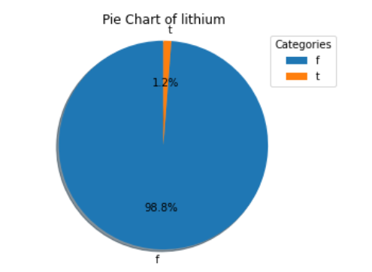
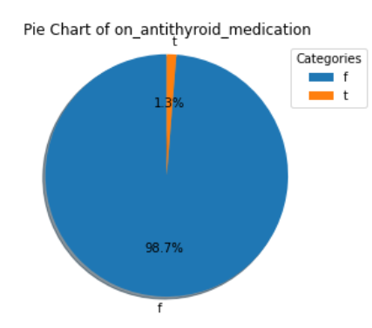
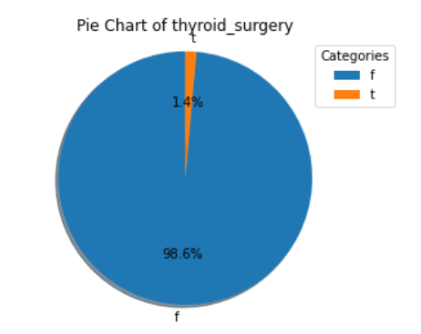
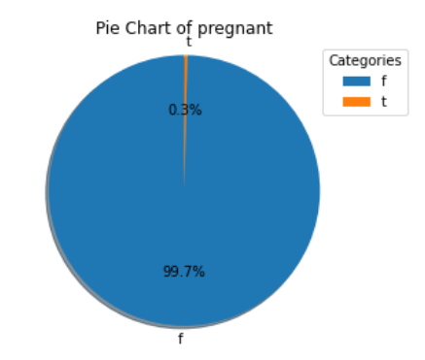
Graphical Representation

Slide 25
Analysis
Used Algorithms | Training Accuracy | Testing Accuracy
Logistic Regression | 85.90% | 86.82%
Support Vector Machine | 86.08% | 87.02%
Decision Tree | 100% | 95.08%
Random Forest | 100% | 96.44%
XGBoost | 98.37% | 96.02%
AdaBoost | 92.78% | 94.97%
KNN | 88.80% | 85.77%

Slide 26
Analysis
Used Algorithms(PCA) | Training Accuracy | Testing Accuracy
Logistic Regression | 77.55% | 77.61%
Support Vector Machine | 86.08% | 87.02%
Decision Tree | 100% | 94.45
Random Forest | 100% | 96.33%
XGBoost | 97.93% | 95.60%
AdaBoost | 92.17% | 94.56%
KNN | 88.75% | 85.98%

Slide 27
Conclusions
Machine learning models, specifically Random Forest proved to be effective in detecting thyroid disease. The model achieved an accuracy of 96.44%, indicating its potential for accurate identification.
The Random Forest model, trained on the given dataset, demonstrated a strong ability to discriminate between thyroid disease and non-thyroid disease cases. This highlights the potential of machine learning in assisting healthcare professionals in accurate disease diagnosis.
The selected features in the dataset played a crucial role in the accuracy of the model.
The results obtained from this project suggest that machine learning can be a valuable tool in assisting with the detection of thyroid disease. However, it should not replace clinical diagnosis or medical expertise. The model can be utilized as a supportive tool for healthcare professionals in making accurate diagnoses, leading to improved patient care.

Slide 28
Future plans
Future work may involve incorporating additional machine learning techniques, exploring different algorithms, and evaluating the model's performance on larger and more diverse datasets.
Continued research and development in the field of machine learning-based thyroid disease detection could lead to more accurate and efficient diagnostic tools in the future.
Additionally, collaborations with domain experts and healthcare professionals can provide valuable insights for refining the model and making it more applicable in real-world clinical settings.

Slide 29
reference
[1] Chandan R, Chetan Vasan, Chethan MS, Devikarani H S, (2021). “THYROID DETECTION USING MACHINE LEARNING” published on IJEAST
[2] R.Vanitha, Dr. K. Perumal, Department of Computer Applications, Madurai Kamaraj University, Madurai. “THYROID CANCER DETECTION USING MACHINE LEARNING TECHNIQUES” published on IJCRT
[3]. Faggiano A, Del Prete M, Marciello F, 2018. Marotta V, Ramundo V, Colao A: Thyroid diseases in elderly. Minerva Endocrinol 2011, 36: 211–231.PubMedGoogle Scholar International Journal of Computer Sciences and Engineering Vol.6(1), Jan 2018, EISSN: 2347-2693 ©, IJCSE All Rights Reserved 331.
UCI Repository, scikit-learn, ML libraries.

Slide 30
Thank You.

